Slide 1

Next Presentation:
A Better Way to Flip (Transpose) a SAS® Dataset
Presenter: Arthur Tabachneck
Art holds a PhD from Michigan State University, has been a SAS user since 1974, is president of the Toronto Area SAS Society and has received such recognitions as the SAS Customer Value Award (1999), SAS-L Hall of Fame (2011), SAS Circle of Excellence (2012) and, in 2012, was recognized as being the first SAS user to have been awarded more than 10,000 points on the SAS Discussion Forums
Notes:
Copyright © 2010, SAS Institute Inc. All rights reserved.
1

Slide 2
A Better Way to Flip (Transpose) a SAS® Dataset
Art297
KSharp
Arthur Tabachneck
Thornhill, ON Canada
Xia Ke Shan
Beijing, China
Joe Whitehurst Robert Vergile
Atlanta, GA Lexington, MA
Astounding

Slide 3
Presentation Overview
What the %transpose macro is
How the macro works
The macro's benefits
Notes:
#SASGF11
Copyright © 2010, SAS Institute Inc. All rights reserved.
3

Slide 4
What the %transpose macro is
It's a SAS macro
Looks and feels almost exactly like PROC TRANSPOSE
Doesn't have all of the capabilities of PROC TRANSPOSE as it was designed for just one purpose: to convert tall files into wide files
Has virtually the same options and statements as PROC TRANSPOSE + a few more
Is easier to use than PROC TRANSPOSE
Runs significantly faster than
PROC TRANSPOSE
Notes:
#SASGF11
Copyright © 2010, SAS Institute Inc. All rights reserved.
4

Slide 5
Have you ever had to flip a SAS dataset
from being tall to being wide?
i.e., from:
idnum | date | var1
1 | 2001JAN | SD
1 | 2001FEB | EF
1 | 2001MAR | HK
2 | 2001JAN | GH
2 | 2001APR | MM
2 | 2001MAY | JH
Notes:
#SASGF11
Copyright © 2010, SAS Institute Inc. All rights reserved.
5

Slide 6
flipping a SAS dataset
to:
idnum | var1_2001JAN | var1_2001FEB | var1_2001MAR | var1_2001APR | var1_2001MAY
1 | SD | EF | HK
2 | GH |  |  | MM | JH
Notes:
#SASGF11
Copyright © 2010, SAS Institute Inc. All rights reserved.
6

Slide 7
if you have, you are probably already familiar with
PROC TRANSPOSE
proc transpose
data=have
out=want (drop=_:)
prefix=var1_;
by idnum;
var var1;
id date;
run;
Not difficult, but you need to know
which are options
which are statements
that you have to "drop" unwanted system variables
and that you have to specify a prefix
Notes:
#SASGF11
Copyright © 2010, SAS Institute Inc. All rights reserved.
7

Slide 8
would you be interested in knowing how to
obtain the same result with the following code?
it may look like the PROC TRANSPOSE code, but:
No system variables to drop
%transpose( data=have, out=want,
by=idnum, var=var1,
id=date, delimiter=_)
No need for a prefix (var names automatically included)
No need to differentiate between options and statements
as they are all of the form: parameter=value,
easier to code (less to type)
runs 10 times faster than PROC TRANSPOSE
Notes:
#SASGF11
Copyright © 2010, SAS Institute Inc. All rights reserved.
8

Slide 9
if you needed to flip a more complex
SAS dataset from being tall to being wide
i.e., from:
idnum | date | var1 | var2
1 | 31MAR2013 | 1 | SD
1 | 30JUN2013 | 2 | EF
1 | 30SEP2013 | 3 | HK
1 | 31DEC2013 | 4 | HL
2 | 31MAR2013 | 5 | GH
2 | 30JUN2013 | 6 | MM
2 | 30SEP2013 | 7 | JH
2 | 31DEC2013 | 8 | MS
Notes:
#SASGF11
Copyright © 2010, SAS Institute Inc. All rights reserved.
9

Slide 10
flipping a more complex SAS dataset
to:
idnum | var1 Qtr1 | var2 Qtr1 | var1 Qtr2 | var2 Qtr2 | var1 Qtr3 | var2 Qtr3 | var1 Qtr4 | var2 Qtr4
1 | 1 | SD | 2 | EF | 3 | HK | 4 | HL
2 | 5 | GH | 6 | MM | 7 | JH | 8 | MS
Notes:
#SASGF11
Copyright © 2010, SAS Institute Inc. All rights reserved.
10

Slide 11
Again, you could use PROC TRANSPOSE
but it would require two steps
First you have to make the table even taller (i.e.,
one record for each by variable and var combination)
proc transpose data=have out=tall ;
by idnum date;
var var1-var2;
format date qtr1.;
run;
Notes:
#SASGF11
Copyright © 2010, SAS Institute Inc. All rights reserved.
11

Slide 12
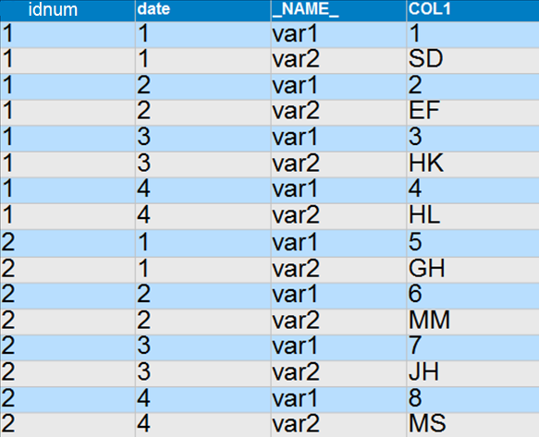
That will create a taller file
(i.e., 1 record for each by variable and var combination)
Notes:
#SASGF11
Copyright © 2010, SAS Institute Inc. All rights reserved.
12

Slide 13

That will create a taller file
(with var names now in _NAME_ and values in COL1)
Notes:
#SASGF11
Copyright © 2010, SAS Institute Inc. All rights reserved.
13

Slide 14
Then, to make the table wide
(i.e., one record for each by variable)
You need to run PROC TRANSPOSE a 2nd time
proc transpose data=tall out=want (drop=_:)
delimiter=_Qtr;
by idnum;
id _name_ date;
var col1;
run;
Notes:
#SASGF11
Copyright © 2010, SAS Institute Inc. All rights reserved.
14

Slide 15
But there are some problems with the method
result:
idnum | var1 Qtr1 | var2 Qtr1 | var1 Qtr2 | var2 Qtr2 | var1 Qtr3 | var2 Qtr3 | var1 Qtr4 | var2 Qtr4
1 | 1 | SD | 2 | EF | 3 | HK | 4 | HL
2 | 5 | GH | 6 | MM | 7 | JH | 8 | MS
The numeric variables are now character variables
Notes:
#SASGF11
Copyright © 2010, SAS Institute Inc. All rights reserved.
15

Slide 16
and if the first idnum was missing data for one date
idnum | date | var1 | var2
1 | 31MAR2013 | 1 | SD
1 | 30JUN2013 | 2 | EF
1 | 31DEC2013 | 4 | HL
2 | 31MAR2013 | 5 | GH
2 | 30JUN2013 | 6 | MM
2 | 30SEP2013 | 7 | JH
2 | 31DEC2013 | 8 | MS
Notes:
#SASGF11
Copyright © 2010, SAS Institute Inc. All rights reserved.
16

Slide 17
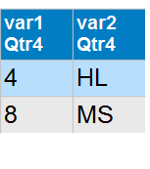
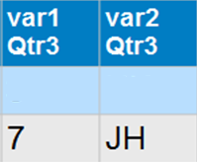
the output variable order will be a bit distorted
idnum | var1 Qtr1 | var2 Qtr1 | var1 Qtr2 | var2 Qtr2 | var1 Qtr3 | var2 Qtr3 | var1 Qtr4 | var2 Qtr4
1 | 1 | SD | 2 | EF | 3 | HK
2 | 5 | GH | 6 | MM | 7 | JH | 8 | MS
Notes:
#SASGF11
Copyright © 2010, SAS Institute Inc. All rights reserved.
17

Slide 18
would you be interested in knowing how to
obtain the right result with the following code?
%transpose(data=have, out=need, by=idnum,
id=date, format=qtr1., delimiter=_Qtr,
var=var1-var2)
How about if you knew that the macro:
only requires one step
only needs one pass through the data
doesn't produce distorted results
can run more than 50 times faster than PROC TRANSPOSE
Notes:
#SASGF11
Copyright © 2010, SAS Institute Inc. All rights reserved.
18

Slide 19
How the macro works
if we have: dataset have
idnum | date | var1 | var2
1 | 31MAR2013 | 1 | SD
1 | 30JUN2013 | 2 | EF
1 | 30SEP2013 | 3 | HK
1 | 31DEC2013 | 4 | HL
2 | 31MAR2013 | 5 | GH
2 | 30JUN2013 | 6 | MM
2 | 30SEP2013 | 7 | JH
2 | 31DEC2013 | 8 | MS
Notes:
#SASGF11
Copyright © 2010, SAS Institute Inc. All rights reserved.
19

Slide 20
How the macro works
and we need: dataset need
idnum | var1 Qtr1 | var2 Qtr1 | var1 Qtr2 | var2 Qtr2 | var1 Qtr3 | var2 Qtr3 | var1 Qtr4 | var2 Qtr4
1 | 1 | SD | 2 | EF | 3 | HK | 4 | HL
2 | 5 | GH | 6 | MM | 7 | JH | 8 | MS
and we submit:
%transpose(data=have, out=want, by=idnum,
id=date, format=qtr1., delimiter=_Qtr,
var=var1-var2, sort=yes)
Notes:
#SASGF11
Copyright © 2010, SAS Institute Inc. All rights reserved.
20

Slide 21
How the macro works:
since the sort parameter was set to 'yes', the macro will run
❶: PROC SORT, using the noequals option and only keeping
the necessary variables
❷: the macro will create and run a datastep like the following:
data work.want (drop=date ___: var1-var2);
set work.have (keep=idnum date var2 var1);
by idnum notsorted;
retain want_chr want_num;
array have_chr(*)$ var2; array have_num(*) var1;
array want_chr(*)$ var2_Qtr1 var2_Qtr2 var2_Qtr3 var2_Qtr4;
array want_num(*) var1_Qtr1 var1_Qtr2 var1_Qtr3 var1_Qtr4;
if first.idnum then call missing(of want_chr(*));
___nchar=put(date,labelfmt.)*dim(have_chr);
do ___i=1 to dim(have_chr);
want_chr(___nchar+___i)=have_chr(___i);
end;
if first.idnum then call missing(of want_num(*));
___nnum=put(date,labelfmt.)*dim(have_num);
do ___i=1 to dim(have_num);
want_num(___nnum+___i)=have_num(___i);
end;
if last.idnum then output;
run;
labelfmt. is a format, created by the macro, and reflects the ordered names of the transposed variables (i.e., from 1 to n)
Notes:
#SASGF11
Copyright © 2010, SAS Institute Inc. All rights reserved.
21

Slide 22
and you can use almost all the features
that you can with PROC TRANSPOSE
plus some additional ones
%transpose( libname_in=, libname_out=,
data=, out=,
by=, prefix=,
var=, autovars=,
id=, var_first=,
format=, delimiter=,
copy=, drop=,
sort=, sort_options=,
guessingrows=)
Notes:
#SASGF11
Copyright © 2010, SAS Institute Inc. All rights reserved.
22

Slide 23
the %transpose macro's features
parameter: libnames
the names of the SAS libraries where your data reside and where you want the transposed file written
the %transpose() features
%transpose( libname_in=, libname_out=,
data=, out=,
by=, prefix=,
var=, autovars=,
id=, var_first=,
format=, delimiter=,
copy=, drop=,
sort=, sort_options=,
guessingrows=)
* * * * * * F E A T U R E * * * * * *
While data and out can be assigned 1 or 2 level filenames
if your input or output files often use certain libraries
you can assign them to these parameters as defaults
Notes:
#SASGF11
Copyright © 2010, SAS Institute Inc. All rights reserved.
23

Slide 24
the %transpose macro's features
parameter: autovars
determines whether char(acter), num(eric) or all variables should be transposed if the var parameter is null
the %transpose() features
%transpose( libname_in=, libname_out=,
data=, out=,
by=, prefix=,
var=, autovars=,
id=, var_first=,
format=, delimiter=,
copy=, drop=,
sort=, sort_options=,
guessingrows=)
* * * * * * F E A T U R E * * * * * *
Where PROC TRANSPOSE will only include all numeric variables if there is no var statement,
this parameter lets you indicate if you want all
numeric variables, all character variables, or both
Notes:
#SASGF11
Copyright © 2010, SAS Institute Inc. All rights reserved.
24

Slide 25
the %transpose macro's features
parameter: var_first
determines which is named first in transposed variables:
YES: prefix var name delimiter id value
%transpose( libname_in=, libname_out=,
data=, out=,
by=, prefix=,
var=, autovars=,
id=, var_first=,
format=, delimiter=,
copy=, drop=,
sort=, sort_options=,
guessingrows=)
Notes:
#SASGF11
Copyright © 2010, SAS Institute Inc. All rights reserved.
25

Slide 26
the %transpose macro's features
parameter: var_first
determines which is named first in transposed variables:
YES: prefix var name delimiter id value
NO: prefix id value delimiter var name
%transpose( libname_in=, libname_out=,
data=, out=,
by=, prefix=,
var=, autovars=,
id=, var_first=,
format=, delimiter=,
copy=, drop=,
sort=, sort_options=,
guessingrows=)
Notes:
#SASGF11
Copyright © 2010, SAS Institute Inc. All rights reserved.
26

Slide 27
the %transpose macro's features
parameter: sort
whether the input dataset should be sorted (YES or NO):
%transpose( libname_in=, libname_out=,
data=, out=,
by=, prefix=,
var=, autovars=,
id=, var_first=,
format=, delimiter=,
copy=, drop=,
sort=, sort_options=,
guessingrows=)
* * * * * * F E A T U R E * * * * * *
If set to YES this parameter will ensure that
your data are automatically presorted
Notes:
#SASGF11
Copyright © 2010, SAS Institute Inc. All rights reserved.
27

Slide 28
How many of you have ever:
forgotten to run proc sort before running another proc that required sorted data?
run proc sort before another proc only to discover that the file hadn't been sorted?
run proc sort before another proc but didn't include a keep dataset option to limit the amount of data that had to be processed?
run proc sort but didn't include the noequals option?
Notes:
#SASGF11
Copyright © 2010, SAS Institute Inc. All rights reserved.
28

Slide 29
Compare the performance of the following three sets of almost identical code run on a file with 40,000 records and 1,002 variables
PROC SORT data=have out=need;
by idnum date;
run; took 6.96 seconds CPU time
DATA need;
set need;
_name_="var1";
run; took 3.67 seconds CPU time
PROC TRANSPOSE data=need out=want (drop=_:)
delimiter=_Qtr;
by idnum;
var var1;
id _name_ date;
format date Qtr1.;
run; took 1.51 seconds CPU time
Notes:
#SASGF11
Copyright © 2010, SAS Institute Inc. All rights reserved.
29

Slide 30
Compare the performance of the following three sets of almost identical code run on a file with 40,000 records and 1,002 variables
PROC SORT data=have (keep=idnum date var1) out=need
noequals;
by idnum date;
run; took 0.48 seconds CPU time
DATA need;
set need;
_name_="var1";
run; took 0.06 seconds CPU time
PROC TRANSPOSE data=need out=want (drop=_:)
delimiter=_Qtr;
by idnum;
var var1;
id _name_ date;
format date Qtr1.;
run; took 0.43 seconds CPU time
Notes:
#SASGF11
Copyright © 2010, SAS Institute Inc. All rights reserved.
30

Slide 31
Compare the performance of the following three sets of almost identical code run on a file with 40,000 records and 1,002 variables
%transpose( var=var1,
id=date,
format=Qtr1.,
sort=yes,
delimiter=_Qtr)
took 0.46 seconds CPU time
i.e., twice as fast as the optimized code
and 25 times faster than the non-optimized code
+
on a more complex transposition of a larger dataset
the macro ran more than 50 times faster
Notes:
#SASGF11
Copyright © 2010, SAS Institute Inc. All rights reserved.
31

Slide 32
the %transpose macro's features
parameter: sort
whether the input data should be sorted (YES or NO): for both, only &by, &id, &var and &copy variables will be used
%transpose( libname_in=, libname_out=,
data=, out=,
by=, prefix=,
var=, autovars=,
id=, var_first=,
format=, delimiter=,
copy=, drop=,
sort=, sort_options=,
guessingrows=)
* * * * * * F E A T U R E * * * * * *
Where PROC TRANSPOSE will take up unnecessary system time unless you include a keep or drop statement,
the macro will always ensure that
only relevant variables are kept
+ if set to YES this parameter will ensure that your data are presorted using the noequals sort option and any other options you specify in the sort_options parameter
Notes:
#SASGF11
Copyright © 2010, SAS Institute Inc. All rights reserved.
32

Slide 33
the %transpose macro's features
parameter: sort_options
whether additional options should be
specified if the sort parameter is set to YES
%transpose( libname_in=, libname_out=,
data=, out=,
by=, prefix=,
var=, autovars=,
id=, var_first=,
format=, delimiter=,
copy=, drop=,
sort=, sort_options=,
guessingrows=)
* * * * * * F E A T U R E * * * * * *
While the keep and noequals sort options will always be used, based on your data there are other sort options you may want to specify that could increase efficiency and/or ensure that your data are sorted (e.g., presorted, tagsort and force
Notes:
#SASGF11
Copyright © 2010, SAS Institute Inc. All rights reserved.
33

Slide 34
the %transpose macro's features
parameter: guessingrows
the number of rows to be read to determine the correct order for the set of transposed variables
%transpose( libname_in=, libname_out=,
data=, out=,
by=, prefix=,
var=, autovars=,
id=, var_first=,
format=, delimiter=,
copy=, drop=,
sort=, sort_options=,
guessingrows=)
* * * * * * F E A T U R E * * * * * *
With PROC TRANSPOSE the transposed variables
will be in the order they are initially found in the data
this parameter controls the order based on the
values found in the first guessingrows' records
Notes:
#SASGF11
Copyright © 2010, SAS Institute Inc. All rights reserved.
34

Slide 35
the %transpose macro's features
parameter: all parameters
%transpose( libname_in=, libname_out=,
data=, out=,
by=, prefix=,
var=, autovars=,
id=, var_first=,
format=, delimiter=,
copy=, drop=,
sort=, sort_options=,
guessingrows=)
* * * * * * F E A T U R E * * * * * *
Since they are all macro named parameters you have direct control over their default values
If you set them to commonly used values, they don't have to be specified UNLESS you want to change their value
Notes:
#SASGF11
Copyright © 2010, SAS Institute Inc. All rights reserved.
35

Slide 36
Benefits of the approach
less typing thus fewer errors
contains some features that would be nice to see available with all SAS procs
easier to learn than PROC TRANSPOSE
runs faster than PROC TRANSPOSE
insures that you ALWAYS get the benefit of two critical SAS efficiency methods
more likely to provide the desired results
Notes:
#SASGF11
Copyright © 2010, SAS Institute Inc. All rights reserved.
36

Slide 37
Presentation Overview
What the %transpose macro is ✓
How the macro works ✓
The macro's benefits ✓
Notes:
#SASGF11
Copyright © 2010, SAS Institute Inc. All rights reserved.
37

Slide 38
The macro, paper and Powerpoint can be found at:
http://www.sascommunity.org
Notes:
#SASGF11
Copyright © 2010, SAS Institute Inc. All rights reserved.
38

Slide 39
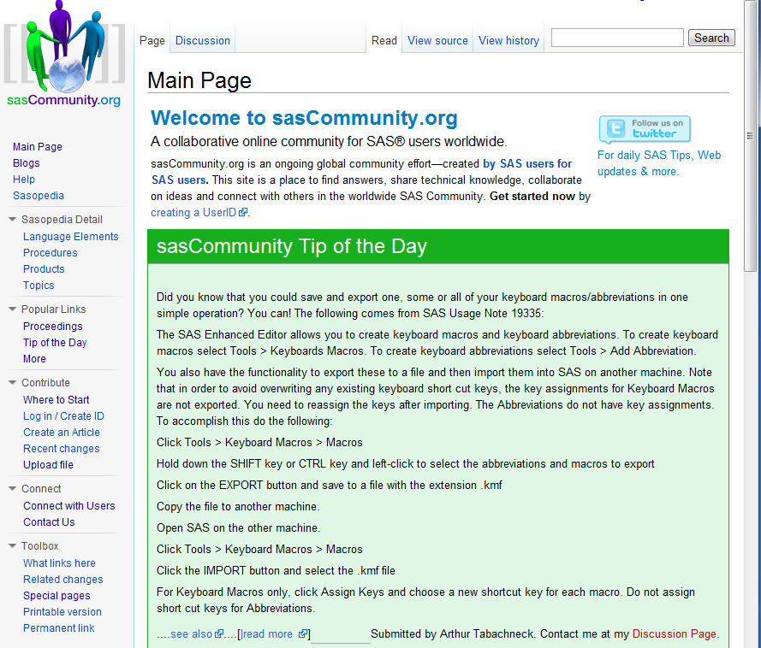

The macro, paper and Powerpoint can be found at:
http://www.sascommunity.org
Notes:
#SASGF11
Copyright © 2010, SAS Institute Inc. All rights reserved.
39

Slide 40
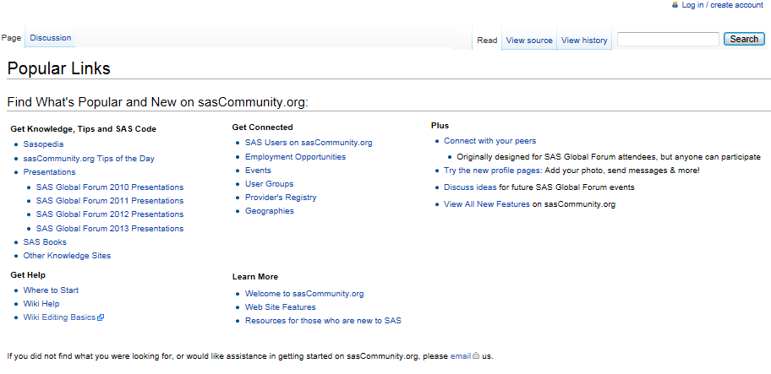

The macro, paper and Powerpoint can be found at:
http://www.sascommunity.org
Notes:
#SASGF11
Copyright © 2010, SAS Institute Inc. All rights reserved.
40

Slide 41
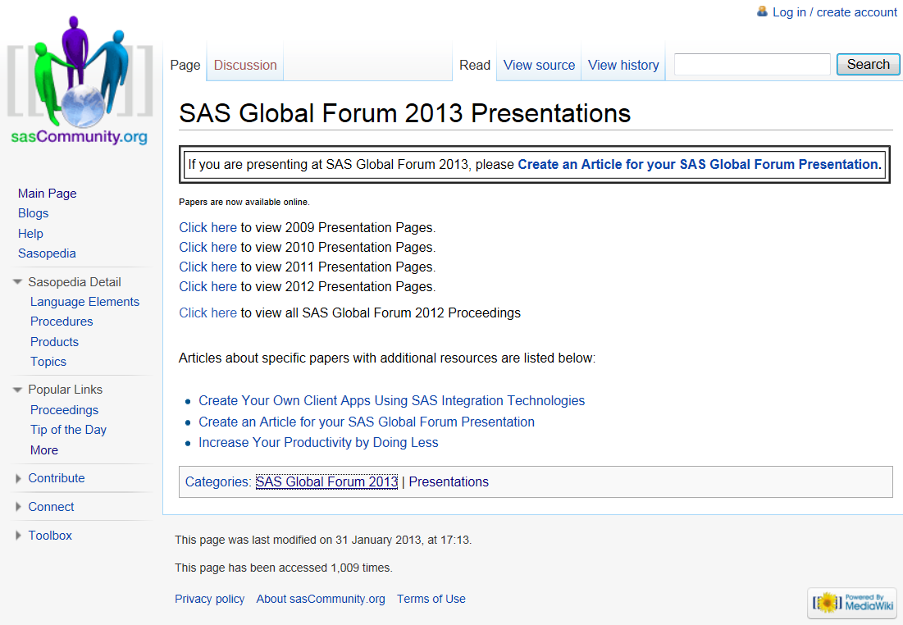

The macro, paper and Powerpoint can be found at:
http://www.sascommunity.org
Notes:
#SASGF11
Copyright © 2010, SAS Institute Inc. All rights reserved.
41

Slide 42
Questions?
Notes:
#SASGF11
Copyright © 2010, SAS Institute Inc. All rights reserved.
42

Slide 43
Your comments and questions
are valued and encouraged
Contact the Authors
Arthur Tabachneck, Ph.D.
President, myQNA, Inc.
Thornhill, ON
art297@rogers.com
Joe Whitehurst
High Impact Technologies
Atlanta, GA
joewhitehurst@gmail.com
Robert Virgile
Robert Virgile Associates, Inc.
Lexington, MA
rvirgile@verizon.net
Xia Ke Shan
Beijing, China
xiakeshan@yahoo.com.cn

